Slide 1
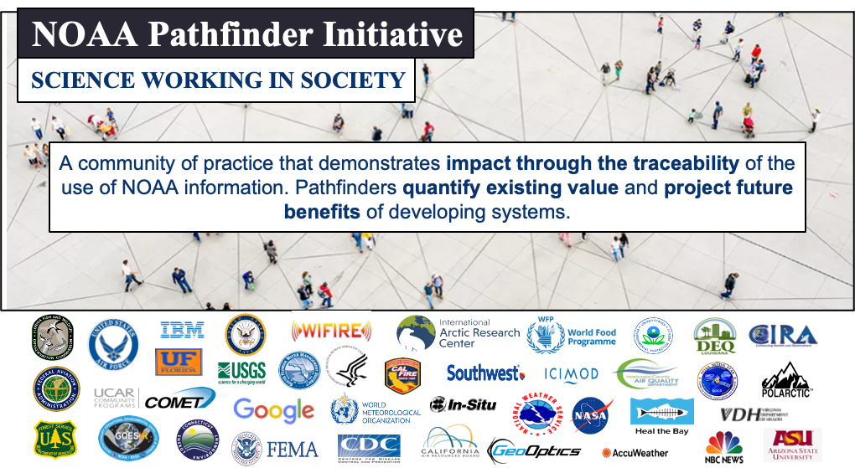
Vanessa M. Escobar
Senior Scientist for NESDIS User Engagement
NOAA Pathfinder Initiative Lead
NOAA NESDIS OSAAP

Slide 2
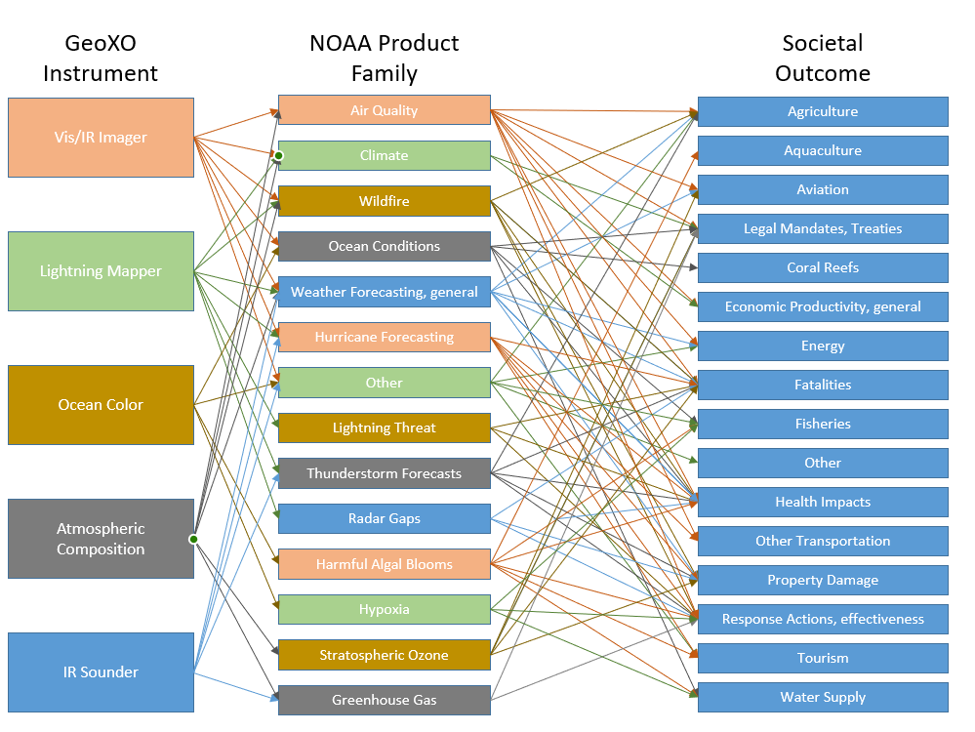
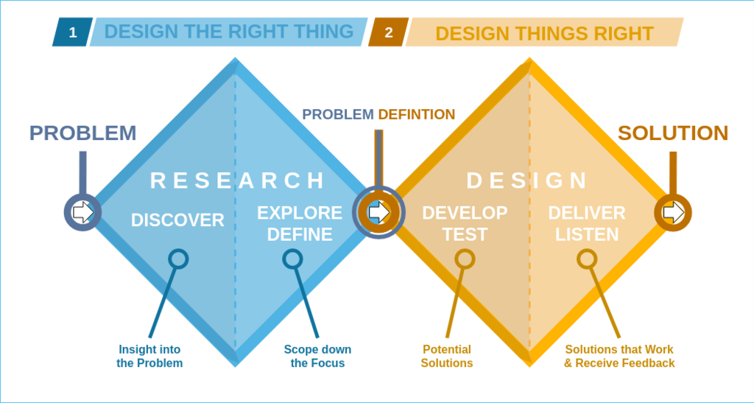
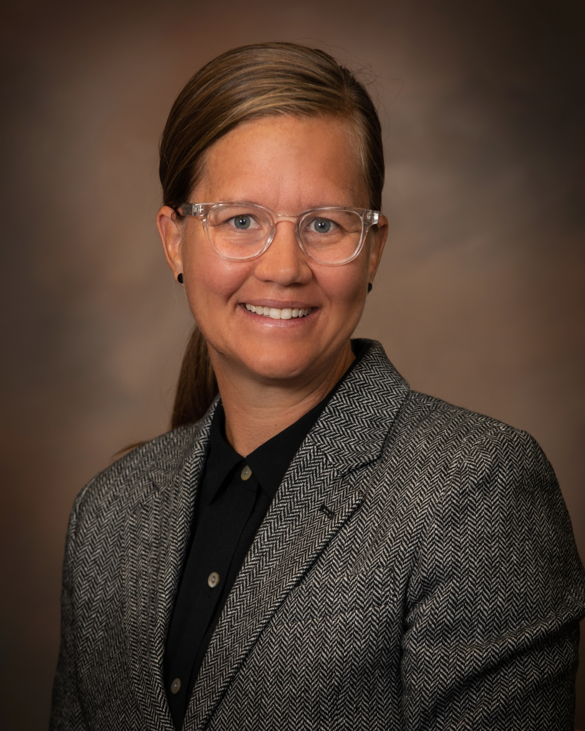
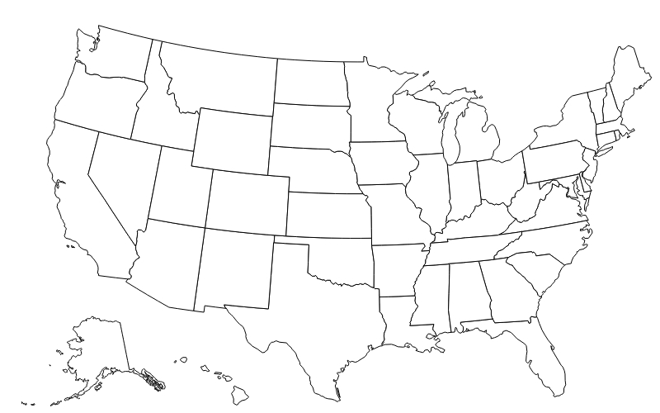


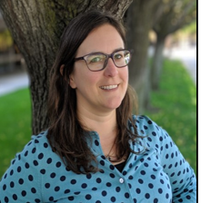

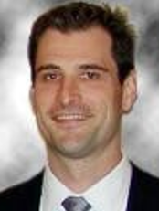
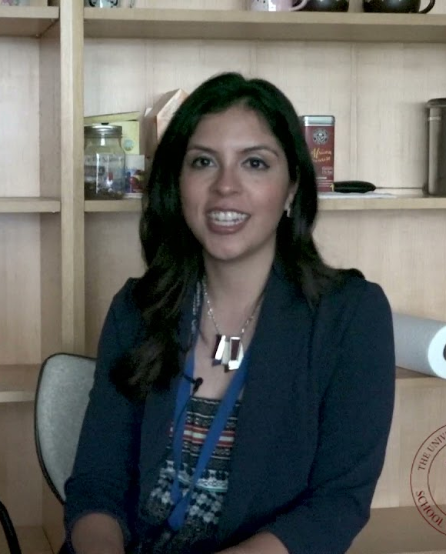
Traceability with NOAA Air Quality Pathfinders
University of Utah
(Heather Holmes)
Utah
Sonoma Technology, Inc
(Nathan Pavlovic)
Sonoma County, CA
NYC Air Quality
(Masha Pitiranggon)
New York City, NY
Pathfinder Use Cases
WIFIRE
(Jessica Block)
Los Angeles County, CA
University of Florida
(Antar Jutla)
Biscayne Bay and Tampa Bay, FL
Arizona State University
(Tim Lant)
Maricopa County, AZ
University of Oklahoma
(Marcela Loria-Salazar)
Oklahoma

Slide 3
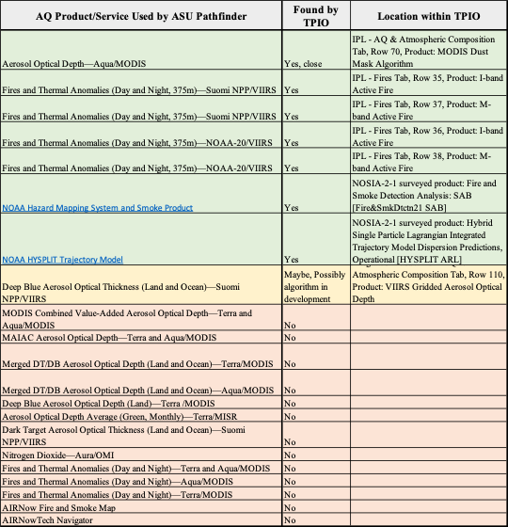
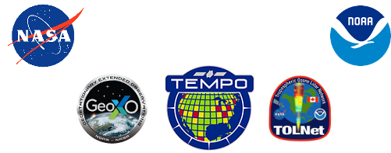
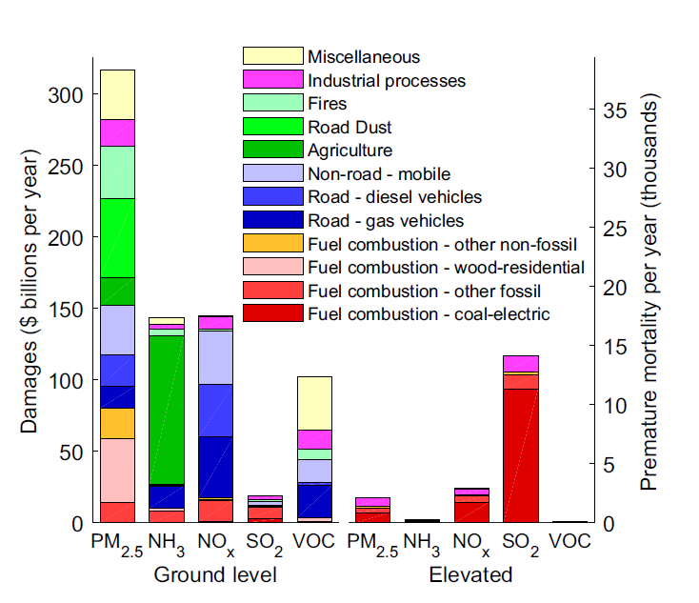
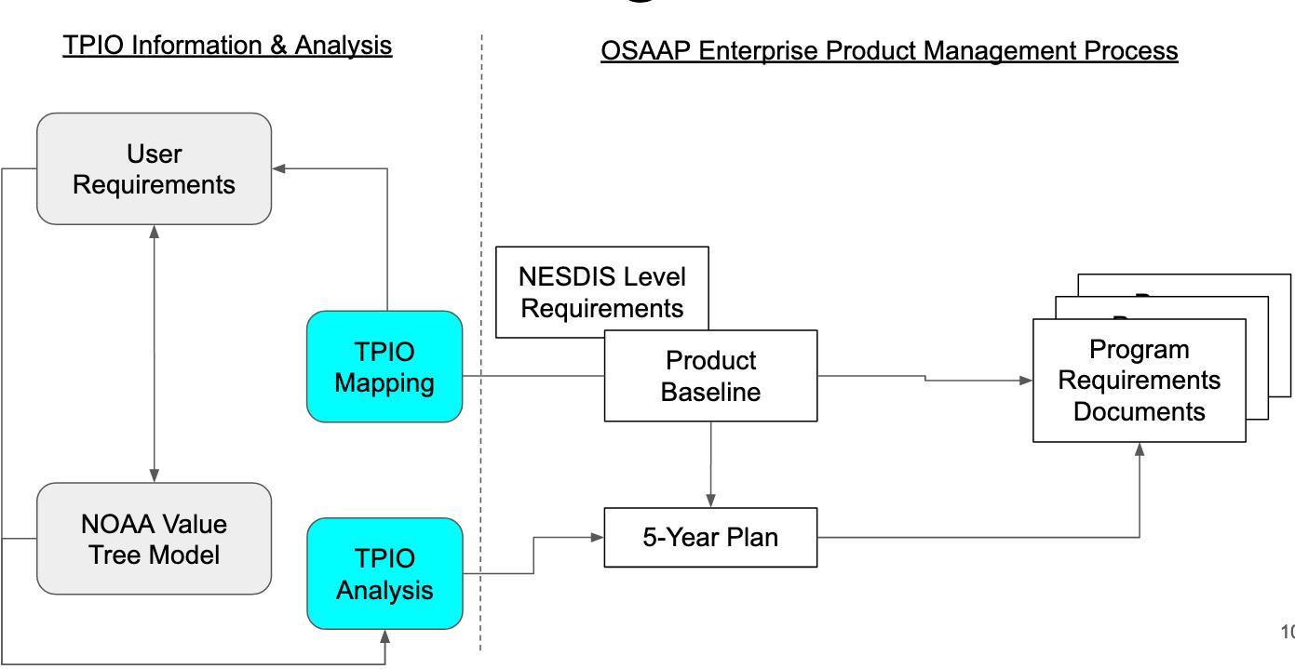
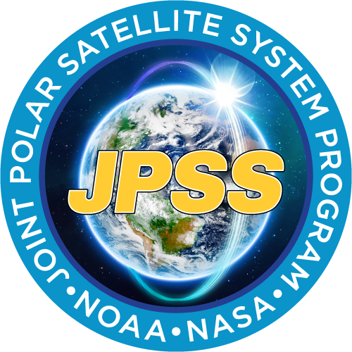
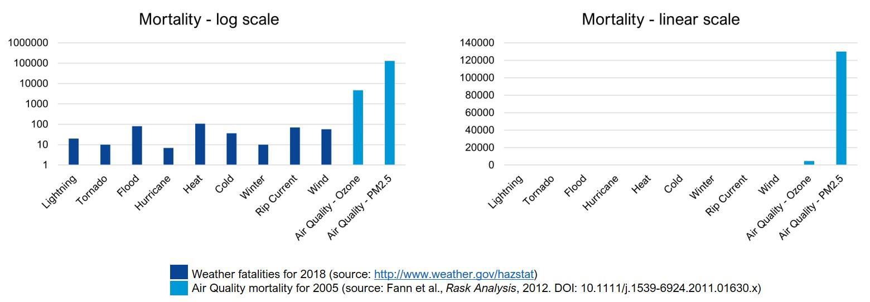
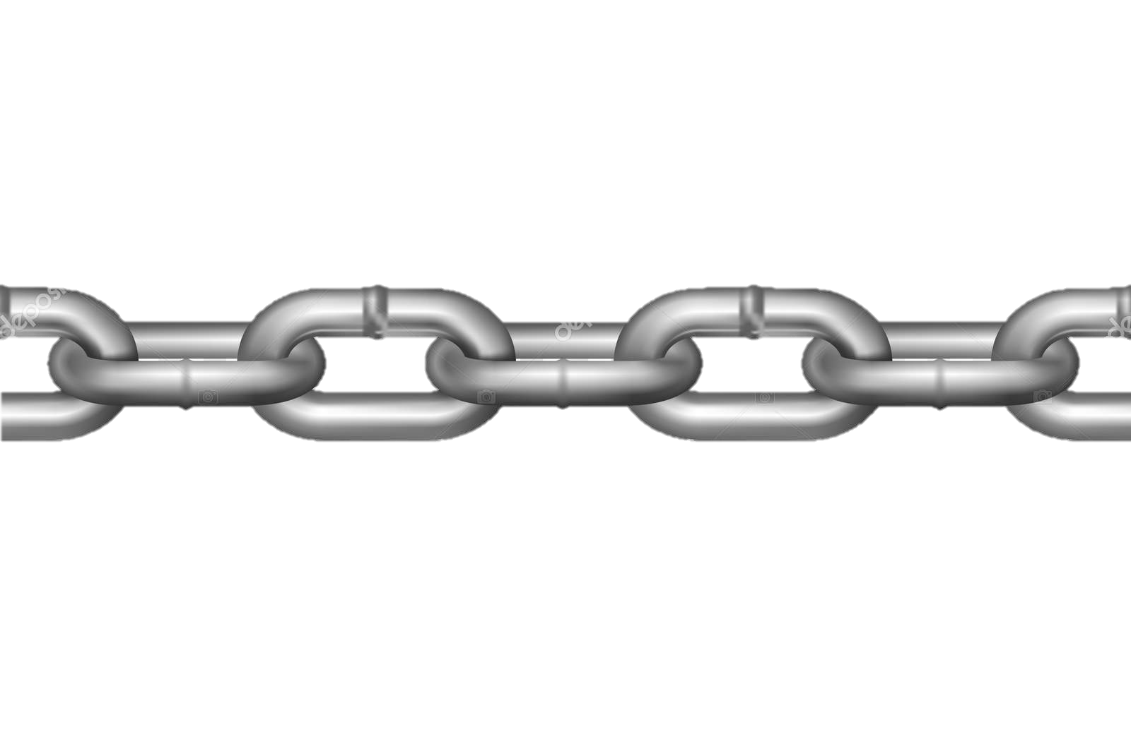
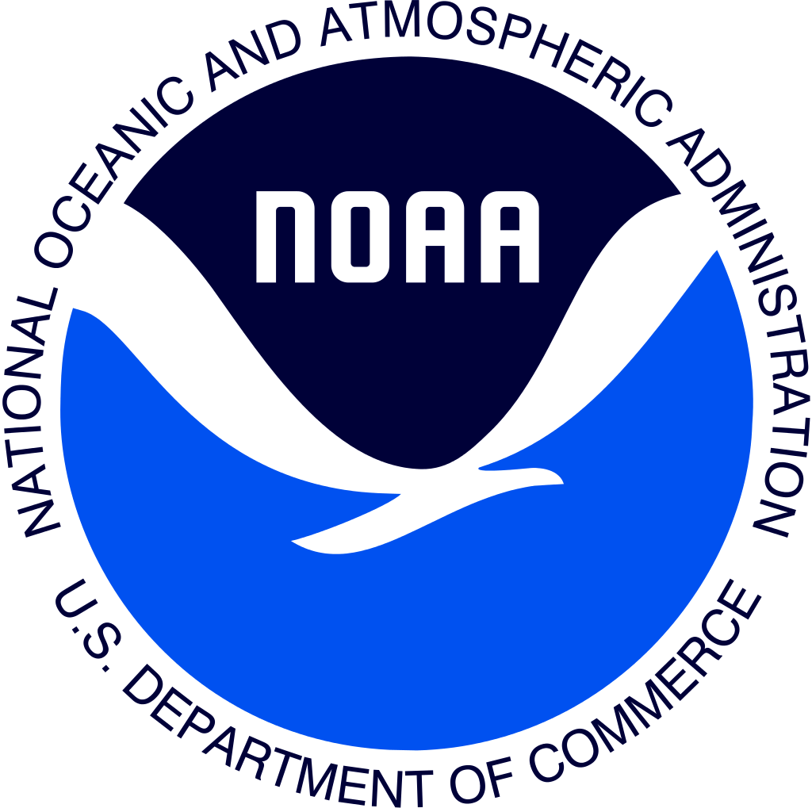

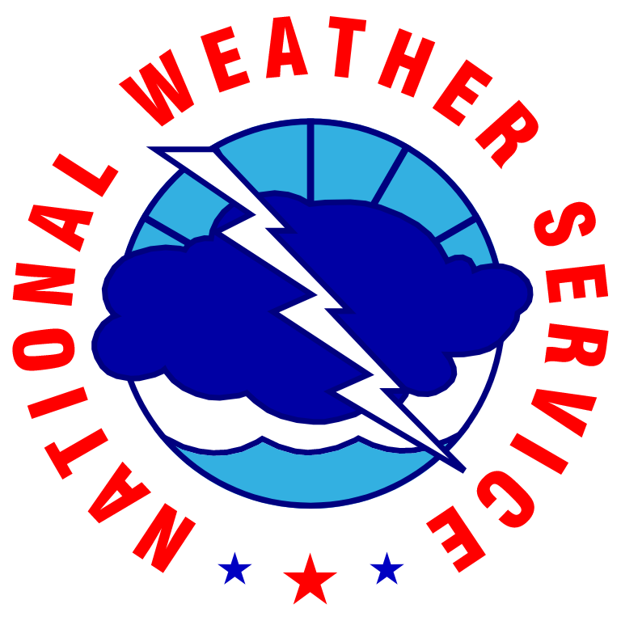




ASU Air Quality TTX Value Chain
U.S. Damages from Air Pollutants by Source
Goodkind et al., Proc. Natl. Acad. Sci., 2019
Benefits for missions, products and services
PM_{2.5}
PM_{2.5}
NO_{x} SO₂ VOC
NH₃
NO_{x} SO₂ VOC
NH₃
GXI
GXS
ACX
Annual U.S. premature mortality
Science Working Groups
Product and Services Development
Demonstrate the value of decisions made at each link in the value chain
Notes:
The pathfinder allows us to understand how and why they use envir data for AQ warnings.
We assess how this information supports decision, how undiscovered products adn services might provide more in foration and how improvements can iform the future products and observation
This points to the mission and the mission instruments, like ACX—> and because this is at the NESDIS Council, we ensure the study also maps to Low Earth Orbit missions as well.

Slide 4
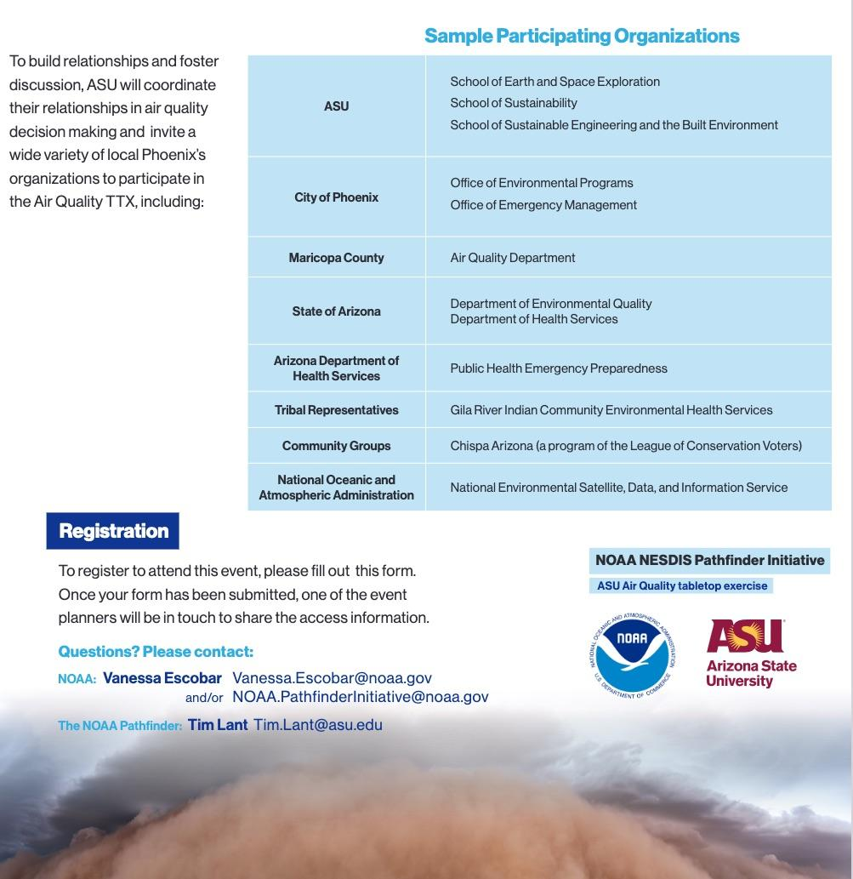
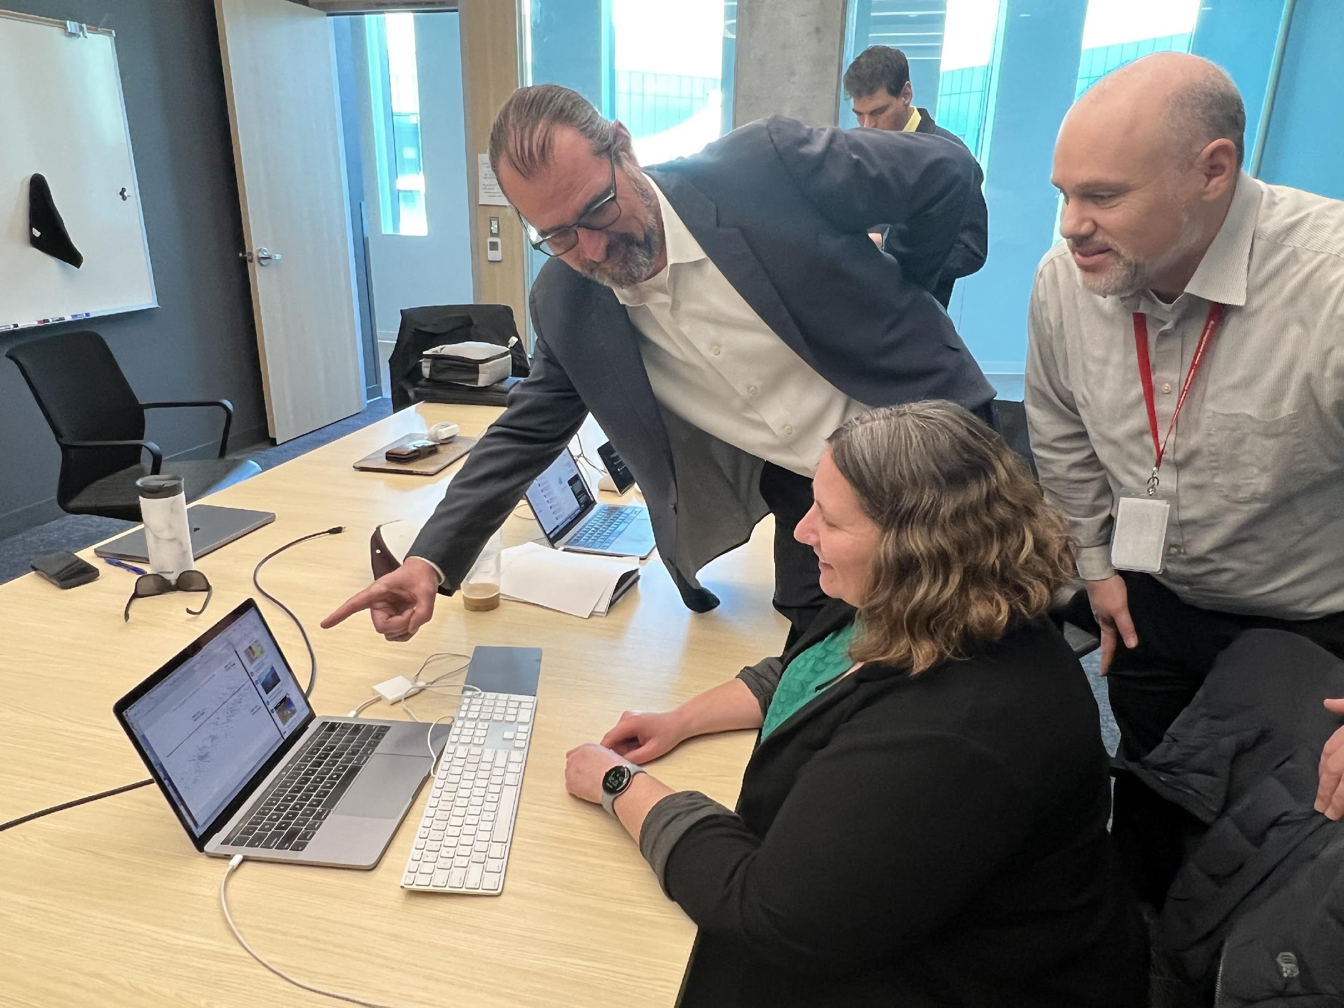

ASU Air Quality Tabletop (TTX) Background
The event will bring together air quality stakeholders from the city, county, and state levels to discuss data needs, decision pathways, and the public health challenges associated with air quality.
The TTX will include three timely scenarios to support value chain development.
Scenario | Pollutants of Concern | Date
Unhealthy air quality days | PM₁₀, PM_{2.5} | December 25, 2022 to January 1, 2023
Extreme heat/ozone | O₃, VOCs | July 16 to July 23, 2022
Haboobs | PM_{2.5} and PM₁₀ | August 31 to September 6, 2022

Slide 5
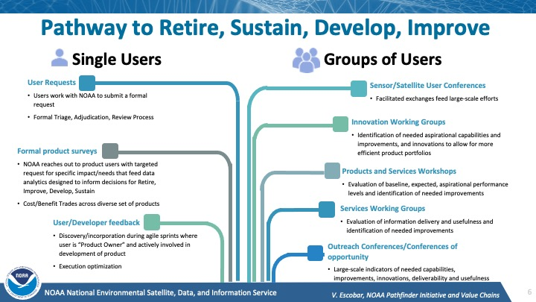


1
2
3
Notes:
Some Benefits to NOAA and the Pathfinder
1.For NOAA: Feedback and prioritization information that feeds critical decisions on products and services
For the User access, awareness and familiarization to missions products and services
2. Benefits to both NOAA and the Pathfinder: The demonstration of the benefits to society and the relationships involved in the decision making process at a local scale.
3. An example of the return investment regarding satellite instruments, products and service AND more importantly For NOAA we get a clear story of impact and value when justifying cost for mission instruments when we are asked to present use cases to congress.

Slide 6
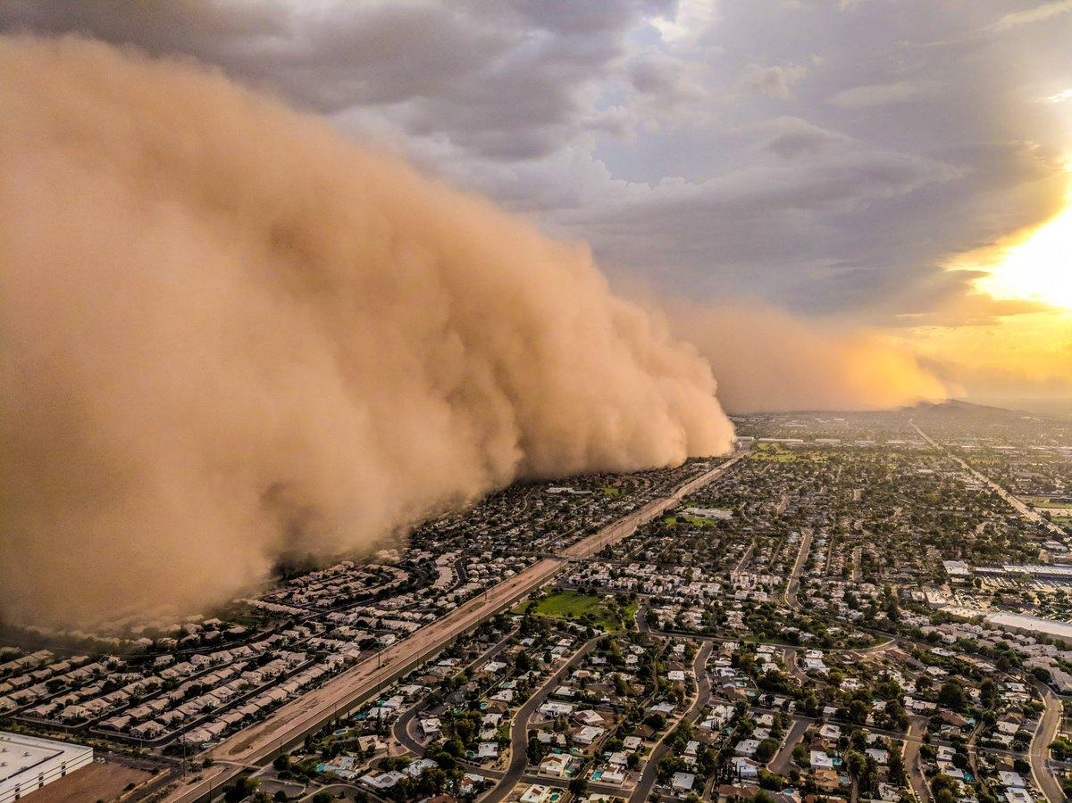
Thank you!
Please contact me for more details: Vanessa.Escobar@NOAA.gov

